Slide 1
IBM University Engagement Project Submission
“Exploring the Power of Agentic AI with IBM Granite and LangFlow”

Slide 2

Project Tile – AI Agent For Electricity Bill Fraud Detection
Domain of Project – Electricity
Student Name | Recent Passport Photo | Email ID | Mobile number [WhatsApp]
Sai Tope |  | topesai36@gmail.com | 9921472645

Slide 3
Problem Statement -
Problem Statement :AI Agent for Electricity Bill Fraud Detection
The Challenge
Electricity fraud and billing anomalies lead to major financial losses for power distribution companies. With thousands of consumers and massive billing data, detecting suspicious consumption patterns manually is extremely difficult. Utilities need an intelligent AI system that can automatically analyze electricity usage data and identify potential fraud cases.
The Objective
Build an AI Agent for Electricity Bill Fraud Detection that analyzes electricity consumption and billing records to detect abnormal patterns and flag potential fraud cases. The solution should:
Electricity Consumption Analysis – Analyze consumer electricity usage data to understand normal consumption behavior and trends.
. Fraud Pattern Identification – Detect suspicious activities such as sudden drops in usage, unusual spikes, or inconsistencies between meter readings and billed units.
. AI-Based Anomaly Detection – Automatically identify consumers whose usage patterns significantly deviate from normal historical behavior.
. Explainable AI Insights – Provide clear explanations for why a particular consumer or electricity bill is flagged as suspicious.

Slide 4
Proposed Solution -
Proposed Solution: AI-Powered Nutrition Agent
The proposed AI Agent for Electricity Bill Fraud Detection uses Artificial Intelligence (AI), Machine Learning (ML), and anomaly detection techniques to automatically identify suspicious electricity billing activities, such as meter tampering, electricity theft, and abnormal consumption patterns. The system collects historical and real-time data from smart meters, billing databases, and customer records, preprocesses the data, and analyzes it using trained machine learning models to detect unusual behavior. Based on the analysis, the agent assigns a fraud risk score, generates explainable alerts, and produces detailed investigation reports for utility officials.
The solution continuously improves its accuracy by learning from confirmed fraud cases and integrates with existing electricity management systems to provide real-time monitoring, reduce revenue losses, improve billing transparency, and support faster, data-driven decision-making.
Develop an AI-powered system to detect electricity bill fraud automatically.
Collect data from smart meters, billing records, and customer databases.
Clean and preprocess the collected data for accurate analysis.
Use Machine Learning algorithms to detect abnormal consumption patterns.
Identify meter tampering, electricity theft, and billing inconsistencies. Compare current electricity usage with historical consumption trends.

Slide 5
Technology Used
Langflow platform -For designing and orchestrating multi-agent workflows visually
IBM Granite model - for eg – ibm-granite-3-2-8b – For natural language understanding, reasoning, and personalization
IBM Cloud – It provides the infrastructure to build, deploy, and scale the Nutrition Agent efficiently. IBM Cloud enables a reliable, secure, and scalable environment for deploying the Nutrition Agent.
RAG– RAG to fetch real data first, then generate intelligent answers, making the Nutrition Agent more trustworthy and effective.
IBM Watsonx.ai - For model deployment, embeddings, and AI governance
Vector Database (FAISS/Chroma) – For RAG-based nutritional data retrieval

Slide 6
Langflow component Used -
Chat Input Accepts the user's query (e.g., "Analyze this electricity bill for fraud").
Prompt Template Defines the AI's role and instructions.
LLM (OpenAI / Gemini / Groq / Ollama) Processes the prompt and performs reasoning on the provided data.
File Input / CSV Loader Uploads electricity billing records, smart meter data, or customer consumption history.
Data Parser / Text Splitter Extracts and structures relevant information from uploaded files.
Conditional Router Routes cases based on fraud score:
Low Risk (0–30)
Medium Risk (31–70)
High Risk (71–100)
Memory Component Maintains conversation context for follow-up investigations.
Output Parser Formats the response into a structured report.
Chat Output Displays:
Fraud Risk Score
Detected anomalies
Possible fraud type
Recommended actions

Slide 7

Role of Agentic AI in the solution
Agentic AI plays a vital role in electricity fraud detection by autonomously monitoring, analyzing, and responding to suspicious electricity consumption and billing activities. Unlike traditional rule-based systems, Agentic AI can make decisions, adapt to new fraud patterns, and collaborate with multiple tools and data sources to detect electricity theft, meter tampering, and billing anomalies more accurately. It continuously processes data from smart meters, billing systems, IoT devices, and customer records to identify unusual consumption patterns, assign fraud risk scores, and generate real-time alerts for utility companies. The AI agent can also automate repetitive tasks such as data collection, report generation, and fraud case prioritization, enabling investigators to focus on high-risk cases. By learning from confirmed fraud incidents, Agentic AI continuously improves its detection models, reducing false positives and increasing detection accuracy. Overall, Agentic AI enhances operational efficiency, minimizes revenue losses, improves billing transparency, supports faster investigations, and enables electricity providers to make data-driven decisions for preventing fraud and ensuring reliable energy distribution

Slide 8
Novelty and Uniqueness
The proposed Nutrition Agent stands out by combining Agentic AI, RAG, and personalization into a single intelligent system.
Multi-Agent Intelligence – Instead of a single chatbot, multiple specialized agents collaborate to deliver accurate and context-aware nutrition guidance.
RAG-Based Accuracy – Integrates real-time data retrieval with AI generation, reducing misinformation and ensuring trustworthy recommendations.
Hyper-Personalization – Tailors diet plans based on health conditions, cultural preferences, and fitness goals.
Real-Time Feedback Loop – Continuously adapts recommendations based on daily food logs and user behavior.
Multi-Modal Input – Supports text, voice, and image-based meal tracking for better usability.
Preventive Healthcare Focus – Goes beyond diet planning to provide disease-specific nutrition advice.
Scalable & Enterprise-Ready – Built on IBM watsonx.ai with IBM Granite models, ensuring reliability and governance.
This makes the solution a smart, adaptive, and proactive digital nutritionist, not just a static diet recommendation tool.

Slide 9
Git Hub Link
Please create public github repository (Enable Add README button while creating repository) with format –
Please test and Paste the working Github URL –
Make sure you have Uploaded following three files into your github repository 1) app.json file , 2) yourproblemstatement.pdf file 3) your projectpresntation.pptx file 4)any other files
·
·
·

Slide 10
Future Scope
Integration with Smart Grids and IoT: The AI agent can be integrated with smart grids and IoT-enabled smart meters to monitor electricity consumption in real time, enabling faster detection of fraud and reducing revenue losses.
Advanced AI and Continuous Learning: Future versions can use advanced machine learning and deep learning models that continuously learn from new fraud patterns, improving detection accuracy while reducing false alarms.
Scalable and Cloud-Based Deployment: The system can be deployed on cloud platforms to monitor millions of consumers across different regions, automate fraud investigations, and support predictive analytics for efficient electricity distribution.
Blockchain for Secure Billing: Future systems can integrate blockchain technology to create tamper-proof billing records and secure transaction logs. This will increase transparency, prevent unauthorized modifications to billing data, and strengthen trust between electricity providers and consumers. Automated Decision Support and Predictive Analytics: The AI agent can evolve into a complete decision-support system by automatically prioritizing high-risk fraud cases, recommending inspection schedules, and predicting future fraud trends. This will help utility companies allocate resources more efficiently and take preventive actions before significant financial losses occur.
·
·
·

Slide 11
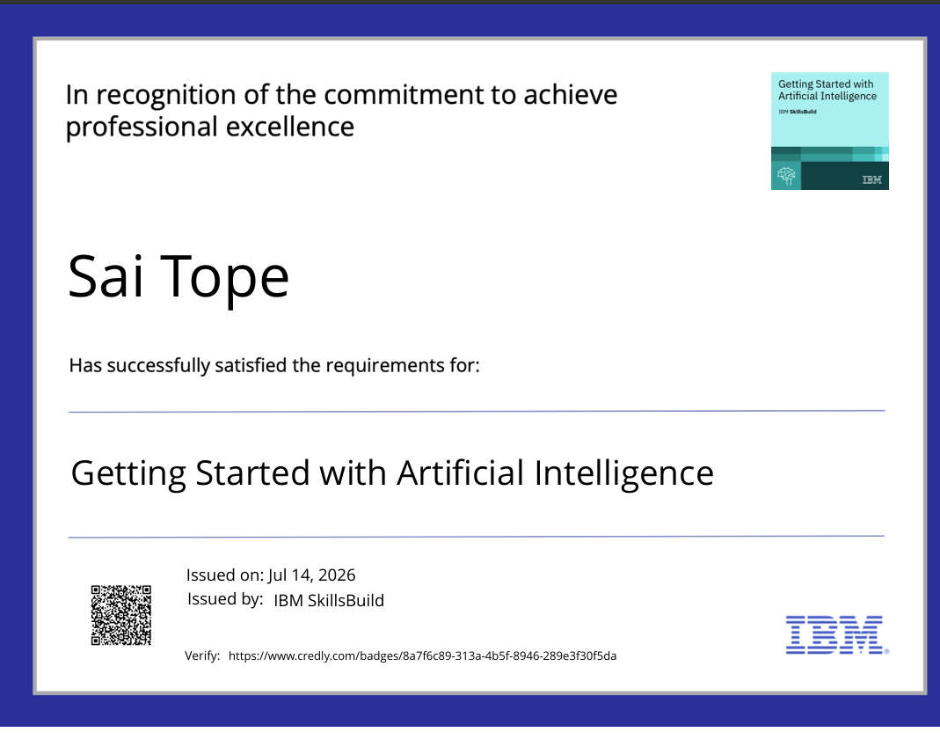
Certificates Earned:
Please add your credly certificate

Slide 12
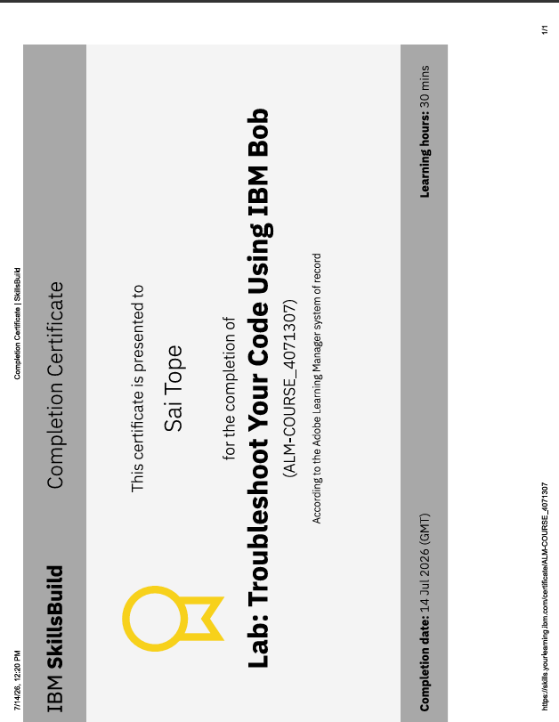
Certificates Earned:​
Add your IBM BOB Certificate

Slide 13


